Slide 1
Root Finding Topics
Bi-section Method
Newton’s method
Uses of root finding for sqrt() and reciprocal sqrt()
Secant Method
Generalized Newton’s method for systems of non-linear equations
  The Jacobian matrix
Fixed-point formulas, Basins of Attraction and Fractals.

Slide 2
Motivation
Many problems can be re-written into a form such as:
  f(x,y,z,…) = 0
  f(x,y,z,…) = g(s,q,…)

Slide 3
Motivation
A root, r, of function f occurs when f(r) = 0.
For example:
  f(x) = x² – 2x – 3
  has two roots at r = -1 and r = 3.
    f(-1) = 1 + 2 – 3 = 0
    f(3) = 9 – 6 – 3 = 0
  We can also look at f in its factored form.
    f(x) = x² – 2x – 3 = (x + 1)(x – 3)

Slide 4
Factored Form of Functions
The factored form is not limited to polynomials.
Consider:
    f(x)= x sin x – sin x.
  A root exists at x = 1.
    f(x) = (x – 1) sin x
Or,
    f(x) = sin πx => x (x – 1) (x – 2) …

Slide 5

Examples
Find x, such that
  x^{p} = c,⇒ x^{p} – c = 0
    Calculate the sqrt(2)
      x² – 2 = 0
Ballistics
  Determine the horizontal distance at which the projectile will intersect the terrain function.

Slide 6
Root Finding Algorithms
Closed or Bracketed techniques
  Bi-section
  Regula-Falsi
Open techniques
  Newton fixed-point iteration
  Secant method
Multidimensional non-linear problems
  The Jacobian matrix
Fixed-point iterations
  Convergence and Fractal Basins of Attraction

Slide 7
Bisection Method
Based on the fact that the function will change signs as it passes thru the root.
    f(a)*f(b) < 0
Once we have a root bracketed, we simply evaluate the mid-point and halve the interval.

Slide 8
Bisection Method
c=(a+b)/2
f(a)>0
f(c)>0
a
c
b
f(b)<0

Slide 9
Bisection Method
Guaranteed to converge to a root if one exists within the bracket.
a = c
f(a)>0
a
c
b
f(c)<0
f(b)<0

Slide 10
Bisection Method
Slowly converges to a root
b = c
f(b)<0
a
c
b

Slide 11
Bisection Method
Simple algorithm:
  Given: a and b, such that f(a)*f(b)<0
  Given: error tolerance, err
  c=(a+b)/2.0; // Find the midpoint
  While( |f(c)| > err ) {
    if( f(a)*f(c) < 0 ) // root in the left half
    b = c;
    else // root in the right half
    a = c;
    c=(a+b)/2.0; // Find the new midpoint
  }
  return c;

Slide 12
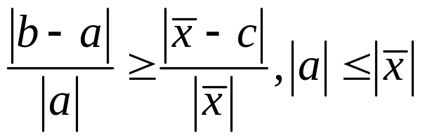
Relative Error
We can develop an upper bound on the relative error quite easily.
a
c
x
b

Slide 13
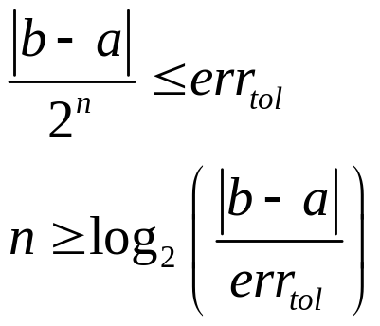
Absolute Error
What does this mean in binary mode?
  err₀ ≤ |b-a|
  err_{i+1} ≤ err_{i}/2 = |b-a|/2^{i+1}
We gain an extra bit each iteration!!!
To reach a desired absolute error tolerance:
  err_{i+1} ≤ err_{tol} ⇒

Slide 14
Absolute Error
The bisection method converges linearly or first-order to the root.
If we need an accuracy of 0.0001 and our initial interval (b-a)=1, then:
      2^{-n} < 0.0001 ⁼⇒ 14 iterations
Not bad, why do I need anything else?

Slide 15
A Note on Functions
Functions can be simple, but I may need to evaluate it many many times.
Or, a function can be extremely complicated. Consider:
    Interested in the configuration of air vents (position, orientation, direction of flow) that makes the temperature in the room at a particular position (teacher’s desk) equal to 72°.
    Is this a function?

Slide 16
A Note on Functions
This function may require a complex three-dimensional heat-transfer coupled with a fluid-flow simulation to evaluate the function. ⇒ hours of computational time on a supercomputer!!!
May not necessarily even be computational.
Techniques existed before the Babylonians.

Slide 17
Root Finding Algorithms
Closed or Bracketed techniques
  Bi-section
  Regula-Falsi
Open techniques
  Newton fixed-point iteration
  Secant method
Multidimensional non-linear problems
  The Jacobian matrix
Fixed-point iterations
  Convergence and Fractal Basins of Attraction

Slide 18
Regula Falsi
In the book under computer problem 16 of section 3.3.
Assume the function is linear within the bracket.
Find the intersection of the line with the x-axis.

Slide 19
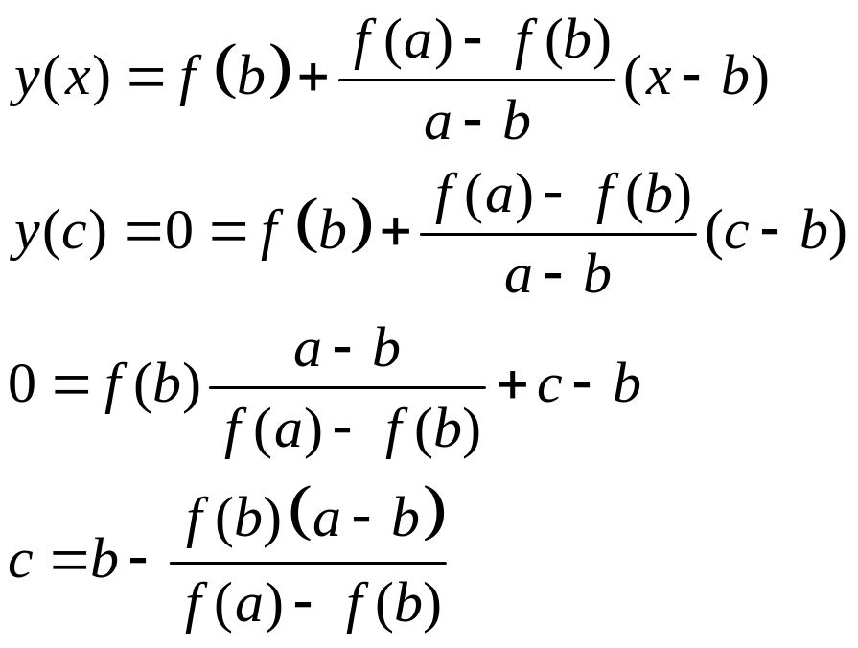
Regula Falsi
f(c)<0
a
c
b

Slide 20
Regula Falsi
Large benefit when the root is much closer to one side.
      Do I have to worry about division by zero?
a
c
b

Slide 21
Regula Falsi
More generally, we can state this method as:
    c=wa + (1-w)b
  For some weight, w, 0≤w ≤ 1.
  If |f(a)| >> |f(b)|, then w < 0.5
    Closer to b.

Slide 22
Bracketing Methods
Bracketing methods are robust
Convergence typically slower than open methods
Use to find approximate location of roots
“Polish” with open methods
Relies on identifying two points a,b initially such that:
    f(a) f(b) < 0
Guaranteed to converge

Slide 23
Root Finding Algorithms
Closed or Bracketed techniques
  Bi-section
  Regula-Falsi
Open techniques
  Newton fixed-point iteration
  Secant method
Multidimensional non-linear problems
  The Jacobian matrix
Fixed-point iterations
  Convergence and Fractal Basins of Attraction

Slide 24
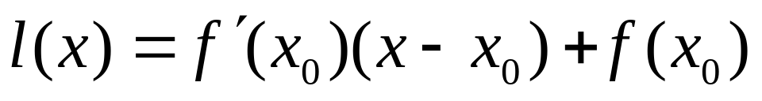
Newton’s Method
Open solution, that requires only one current guess.
Root does not need to be bracketed.
Consider some point x₀.
  If we approximate f(x) as a line about x₀, then we can again solve for the root of the line.

Slide 25
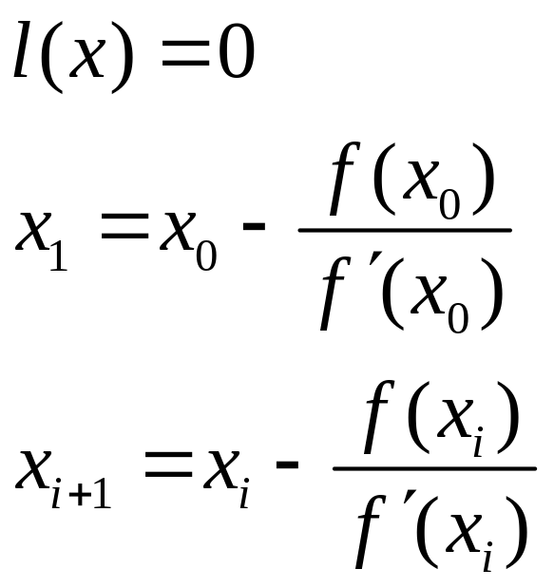
Newton’s Method
Solving, leads to the following iteration:

Slide 26
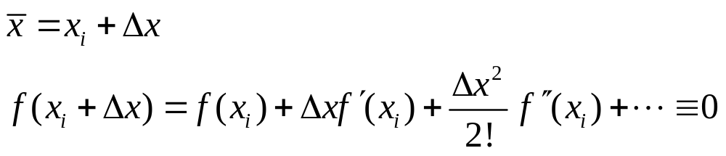
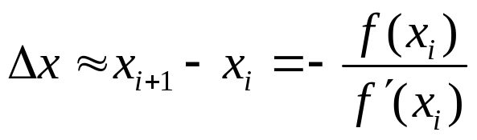
Newton’s Method
This can also be seen from Taylor’s Series.
Assume we have a guess, x₀, close to the actual root. Expand f(x) about this point.
If dx is small, then dx^{n} quickly goes to zero.

Slide 27
Newton’s Method
Graphically, follow the tangent vector down to the x-axis intersection.
x_{i}
x_{i+1}

Slide 28
Newton’s Method
Problems
4
1
3
diverges
x₀
2

Slide 29
Newton’s Method
Need the initial guess to be close, or, the function to behave nearly linear within the range.

Slide 30
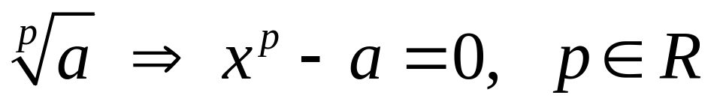
Finding a square-root
Ever wonder why they call this a square-root?
Consider the roots of the equation:
    f(x) = x²-a
This of course works for any power:

Slide 31
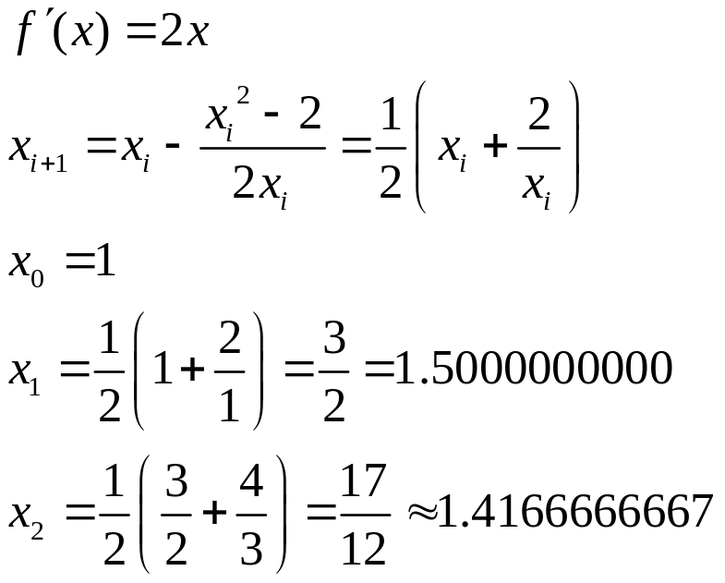
Finding a square-root
Example: √2 = 1.4142135623730950488016887242097
Let x₀ be one and apply Newton’s method.

Slide 32
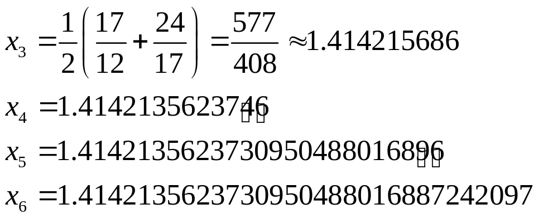
Finding a square-root
Example: √2 = 1.4142135623730950488016887242097
Note the rapid convergence
Note, this was done with the standard Microsoft calculator to maximum precision.

Slide 33
Finding a square-root
Can we come up with a better initial guess?
Sure, just divide the exponent by 2.
  Remember the bias offset
  Use bit-masks to extract the exponent to an integer, modify and set the initial guess.
For √2, this will lead to x₀=1 (round down).

Slide 34
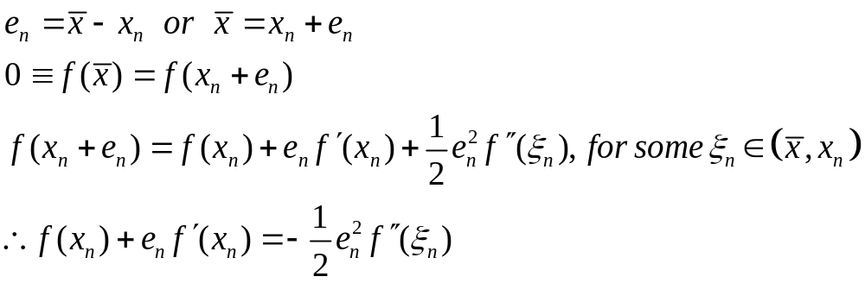
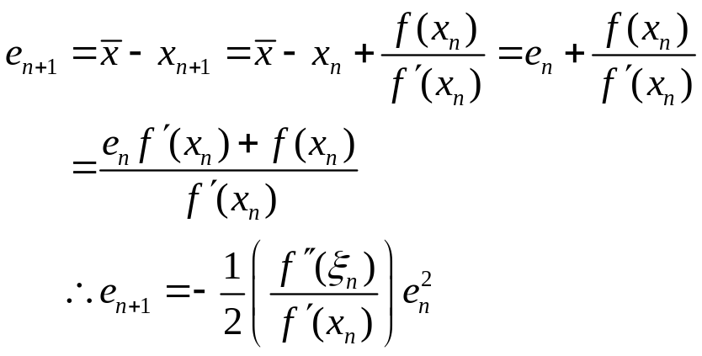
Convergence Rate of Newton’s
Now,

Slide 35
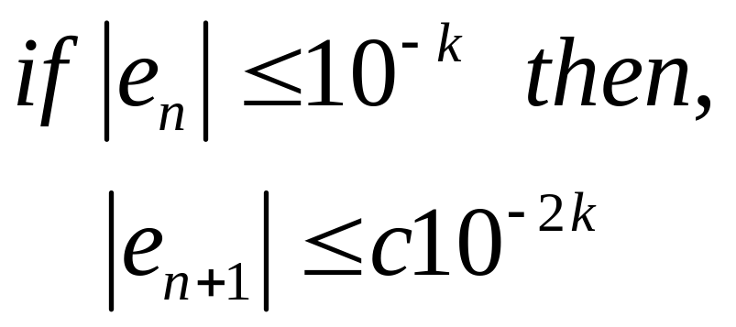
Convergence Rate of Newton’s
Converges quadratically.

Slide 36
Newton’s Algorithm
Requires the derivative function to be evaluated, hence more function evaluations per iteration.
A robust solution would check to see if the iteration is stepping too far and limit the step.
Most uses of Newton’s method assume the approximation is pretty close and apply one to three iterations blindly.

Slide 37
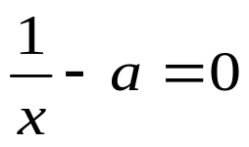
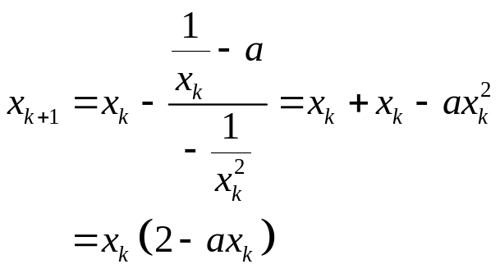
Division by Multiplication
Newton’s method has many uses in computing basic numbers.
For example, consider the equation:
Newton’s method gives the iteration:

Slide 38
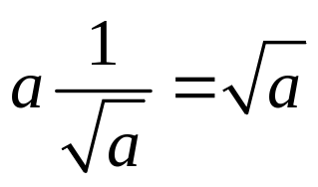
Reciprocal Square Root
Another useful operator is the reciprocal-square root.
  Needed to normalize vectors
  Can be used to calculate the square-root.

Slide 39
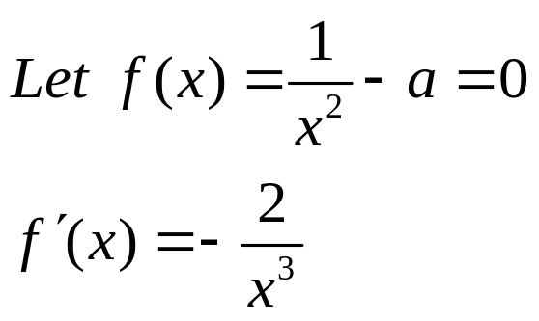
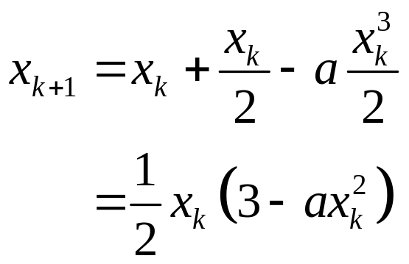
Reciprocal Square Root
Newton’s iteration yields:

Slide 40
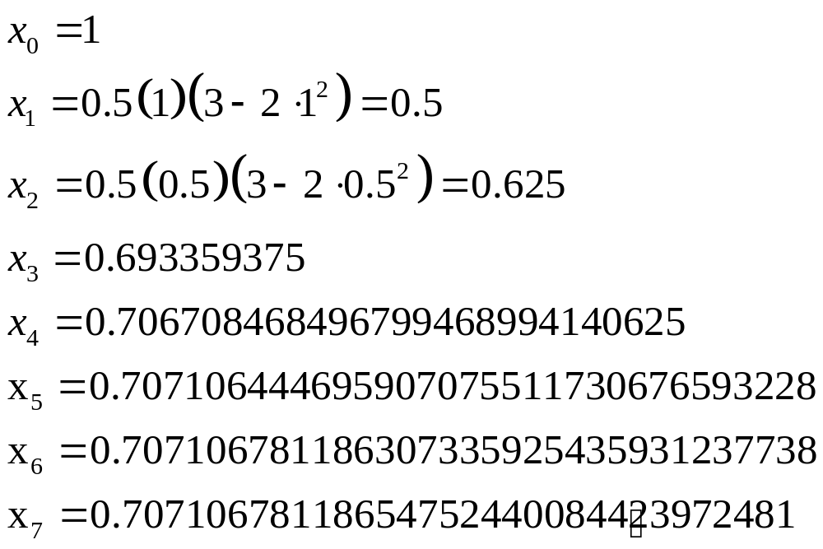
1/Sqrt(2)
Let’s look at the convergence for the reciprocal square-root of 2.
If we could only start here!!

Slide 41
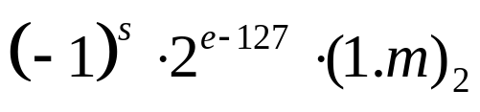
1/Sqrt(x)
What is a good choice for the initial seed point?
  Optimal – the root, but it is unknown
  Consider the normalized format of the number:
  What is the reciprocal?
  What is the square-root?

Slide 42
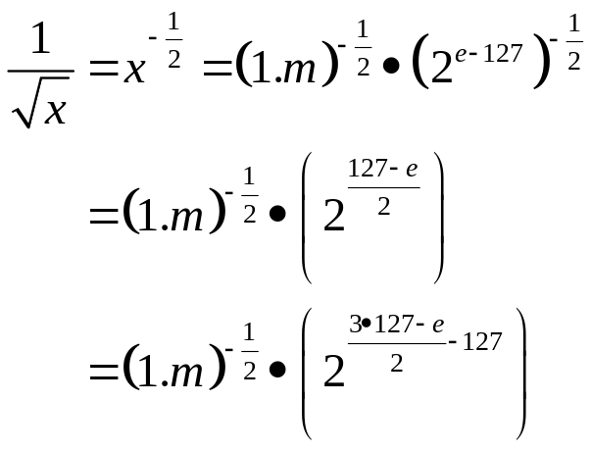
1/Sqrt(x)
Theoretically,
Current GPU’s provide this operation in as little as 2 clock cycles!!! How?
How many significant bits does this estimate have?
New bit-pattern for the exponent

Slide 43
1/Sqrt(x)
GPU’s such as nVidia’s FX cards provide a 23-bit accurate reciprocal square-root in two clock cycles, by only doing 2 iterations of Newton’s method.
Need 24-bits of precision =>
  Previous iteration had 12-bits of precision
  Started with 6-bits of precision

Slide 44
1/Sqrt(x)
Examine the mantissa term again (1.m).
Possible patterns are:
  1.000…, 1.100…, 1.010…, 1.110…, …
Pre-compute these and store the results in a table. Fast and easy table look-up.
A 6-bit table look-up is only 64 words of on chip cache.
Note, we only need to look-up on m, not 1.m.
This yields a reciprocal square-root for the first seven bits, giving us about 6-bits of precision.

Slide 45


1/Sqrt(x)
Slight problem:
  The produces a result between 1 and 2.
  Hence, it remains normalized, 1.m’.
  For , we get a number between ½ and 1.
  Need to shift the exponent.

Slide 46
Root Finding Algorithms
Closed or Bracketed techniques
  Bi-section
  Regula-Falsi
Open techniques
  Newton fixed-point iteration
  Secant method
Multidimensional non-linear problems
  The Jacobian matrix
Fixed-point iterations
  Convergence and Fractal Basins of Attraction

Slide 47
Secant Method
What if we do not know the derivative of f(x)?
Secant line
Tangent vector
x_{i}
x_{i-1}

Slide 48
Secant Method
As we converge on the root, the secant line approaches the tangent.
Hence, we can use the secant line as an estimate and look at where it intersects the x-axis (its root).

Slide 49
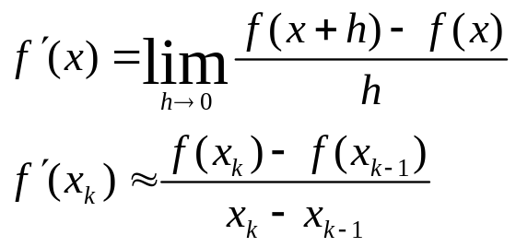
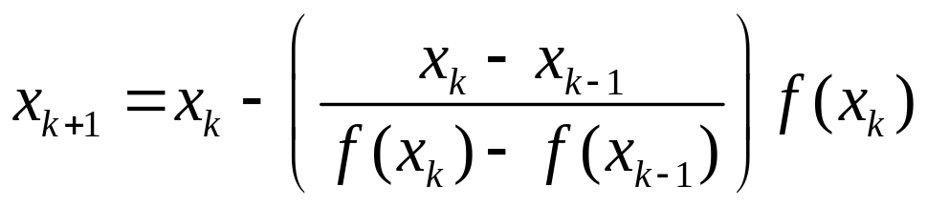
Secant Method
This also works by looking at the definition of the derivative:
Therefore, Newton’s method gives:
Which is the Secant Method.

Slide 50
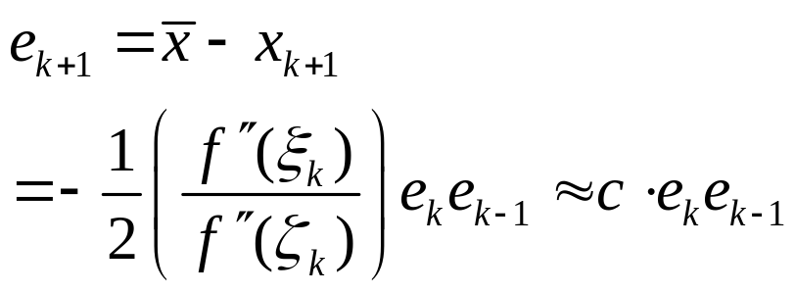
Convergence Rate of Secant
Using Taylor’s Series, it can be shown (proof is in the book) that:

Slide 51
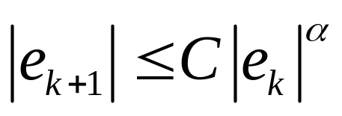
Convergence Rate of Secant
This is a recursive definition of the error term. Expressed out, we can say that:
Where α=1.62.
We call this super-linear convergence.

Slide 52
Root Finding Algorithms
Closed or Bracketed techniques
  Bi-section
  Regula-Falsi
Open techniques
  Newton fixed-point iteration
  Secant method
Multidimensional non-linear problems
  The Jacobian matrix
Fixed-point iterations
  Convergence and Fractal Basins of Attraction

Slide 53
Higher-dimensional Problems
Consider the class of functions
f(x₁,x₂,x₃,…,x_{n})=0,
where we have a mapping from ℜ^{n}→ℜ.
We can apply Newton’s method separately for each variable, x_{i}, holding the other variables fixed to the current guess.

Slide 54
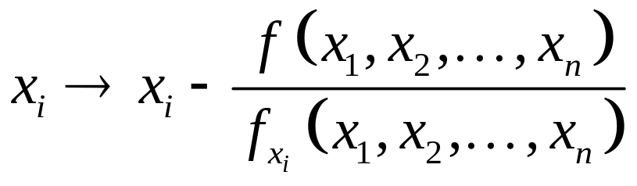
Higher-dimensional Problems
This leads to the iteration:
Two choices, either I keep of complete set of old guesses and compute new ones, or I use the new ones as soon as they are updated.
Might as well use the more accurate new guesses.
Not a unique solution, but an infinite set of solutions.

Slide 55
Higher-dimensional Problems
Example:
    x+y+z=3
  Solutions:
    x=3, y=0, z=0
    x=0, y=3, z=0
    …

Slide 56
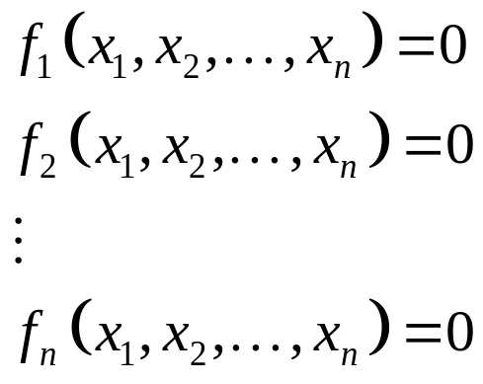
Systems of Non-linear Equations
Consider the set of equations:

Slide 57
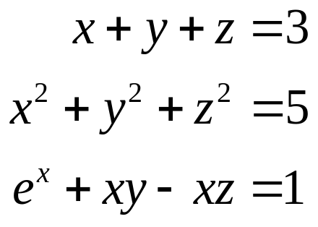
Systems of Non-linear Equations
Example:
Conservation of mass coupled with conservation of energy, coupled with solution to complex problem.
Plane intersected with a
sphere, intersected with a
more complex function.

Slide 58
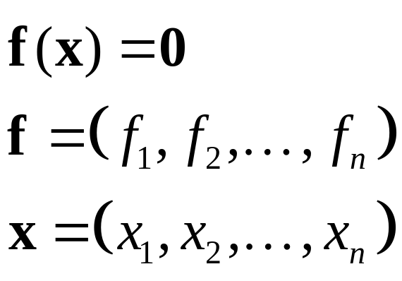
Vector Notation
We can rewrite this using vector notation:

Slide 59
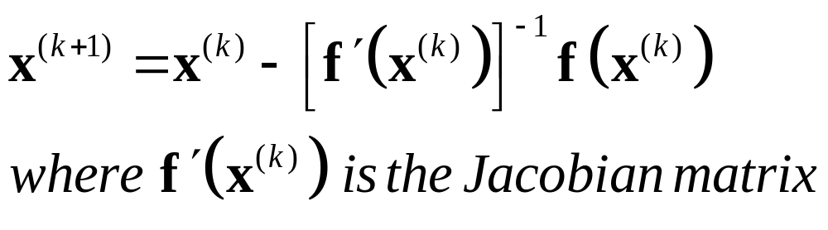
Newton’s Method for
Non-linear Systems
Newton’s method for non-linear systems can be written as:

Slide 60
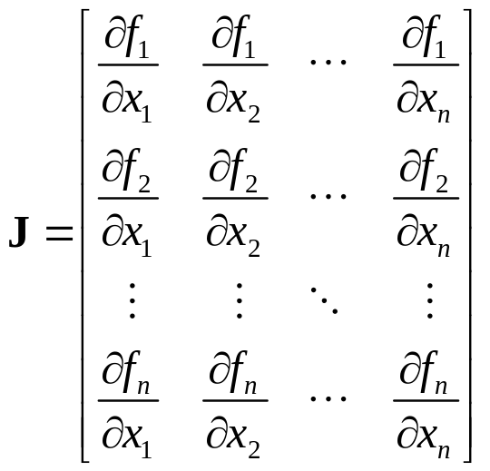
The Jacobian Matrix
The Jacobian contains all the partial derivatives of the set of functions.
Note, that these are all functions and need to be evaluated at a point to be useful.

Slide 61
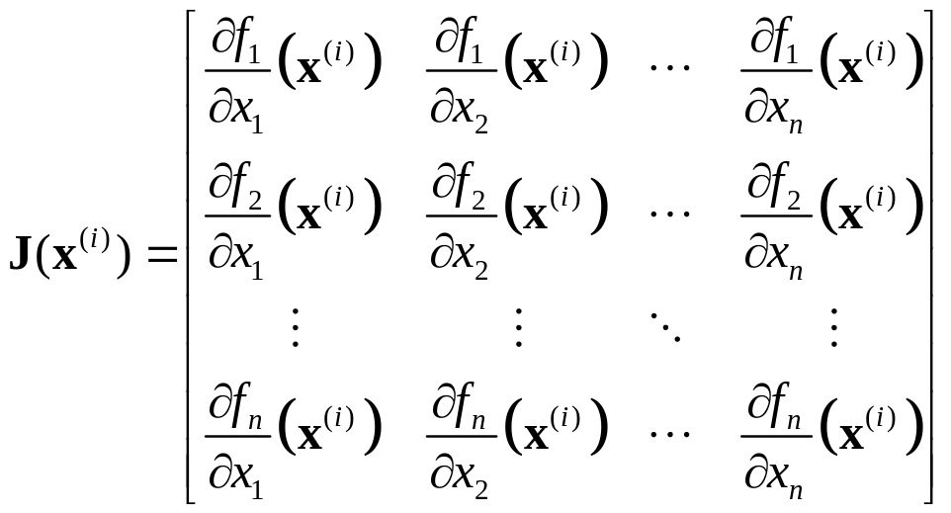
The Jacobian Matrix
Hence, we write

Slide 62
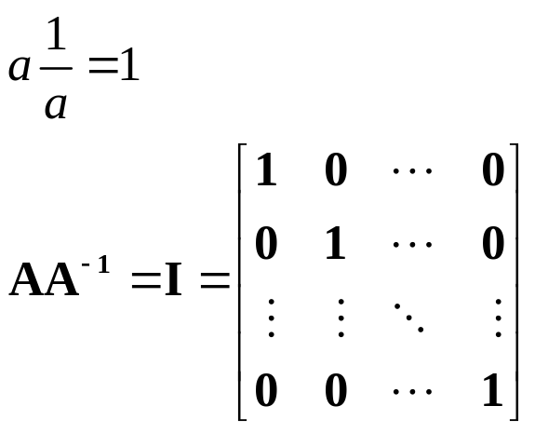
Matrix Inverse
We define the inverse of a matrix, the same as the reciprocal.

Slide 63
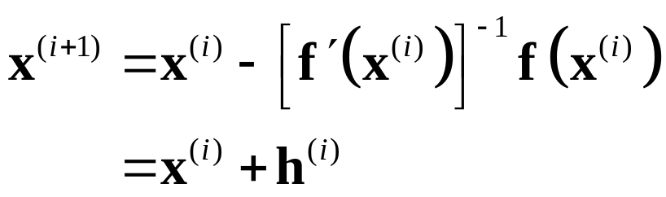
Newton’s Method
If the Jacobian is non-singular, such that its inverse exists, then we can apply this to Newton’s method.
We rarely want to compute the inverse, so instead we look at the problem.

Slide 64
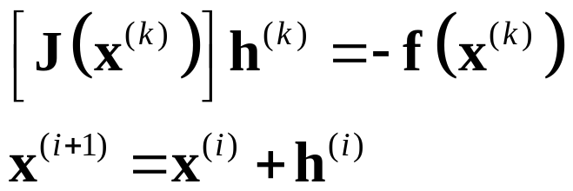
Newton’s Method
Now, we have a linear system and we solve for h.
Repeat until h goes to zero.
  We will look at solving linear systems later in the course.

Slide 65
Initial Guess
How do we get an initial guess for the root vector in higher-dimensions?
In 2D, I need to find a region that contains the root.
Steepest Decent is a more advanced topic not covered in this course. It is more stable and can be used to determine an approximate root.

Slide 66
Root Finding Algorithms
Closed or Bracketed techniques
  Bi-section
  Regula-Falsi
Open techniques
  Newton fixed-point iteration
  Secant method
Multidimensional non-linear problems
  The Jacobian matrix
Fixed-point iterations
  Convergence and Fractal Basins of Attraction

Slide 67
Fixed-Point Iteration
Many problems also take on the specialized form: g(x)=x, where we seek, x, that satisfies this equation.
f(x)=x
g(x)

Slide 68
Fixed-Point Iteration
Newton’s iteration and the Secant method are of course in this form.
In the limit, f(x_{k})=0, hence x_{k+1}=x_{k}

Slide 69
Fixed-Point Iteration
Only problem is that that assumes it converges.
The pretty fractal images you see basically encode how many iterations it took to either converge (to some accuracy) or to diverge, using that point as the initial seed point of an iterative equation.
The book also has an example where the roots converge to a finite set. By assigning different colors to each root, we can see to which point the initial seed point converged.

Slide 70

Fractals
Images result when we deal with 2-dimensions.
Such as complex numbers.
Color indicates how quickly it converges or diverges.

Slide 71
Fixed-Point Iteration
More on this when we look at iterative solutions for linear systems (matrices).

